Slide 1
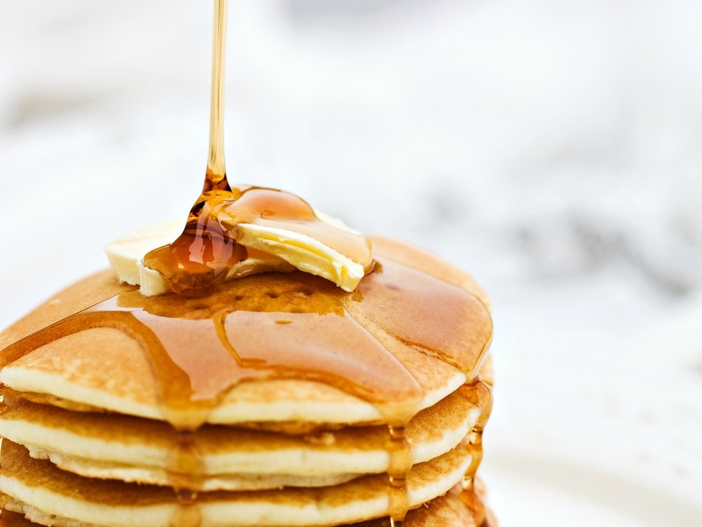
Applebee’s Flapjack Fundraiser
Rachael Jensen, Alyssa Marquiss, Lauren Van Wagenen, Kailyn Balls & Kirsten Balls

Slide 2
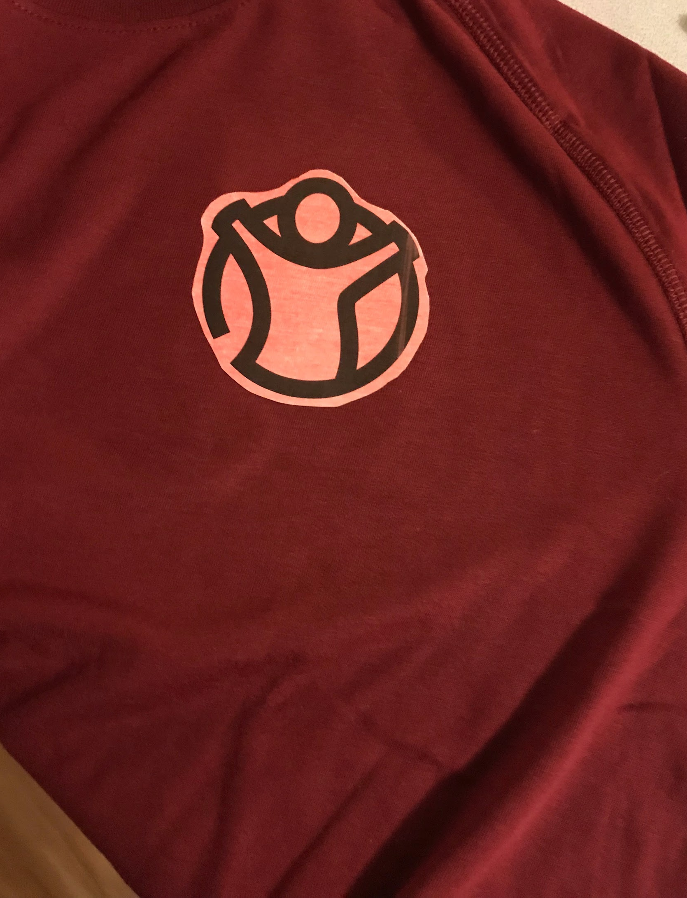
Project Planning
We wanted to do a project focused on Humanitarian relief
Researched for opportunities to fundraise in our area
Contacted Applebee’s asking them about their Flapjack Fundraiser
Set up meeting with Lyle, the head of the fundraiser events to ask questions and discuss details and requirements
Signed a contract with them agreeing that we owe them $400
Turned in a $100 deposit by splitting it to $20/person
Created pre-sale tickets to use for our fundraiser
Allowed to create our own price for the tickets

Slide 3
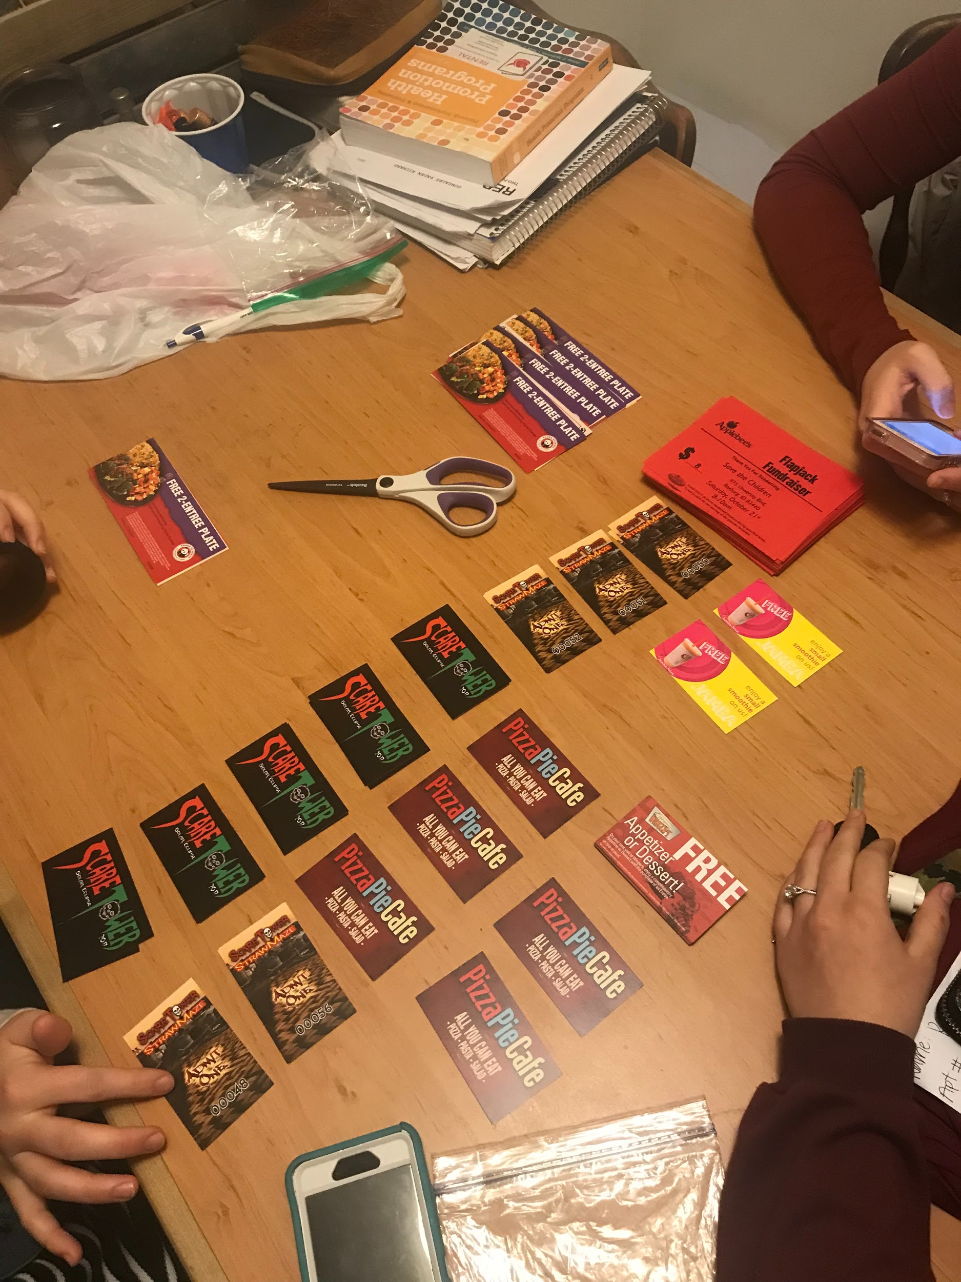
Project Planning
Contacted local businesses to donate coupons or prizes while we advertise their business in return
Jamba Juice, Wingers, Panda Express, Scare Tower, Pizza Pie Café, FatCats contributed prizes
Started telling people about our event in casual conversation to promote the event
Used Social Media quite a bit to advertise our fundraiser
September 28 we posted in multiple Facebook pages advertising our event to the Rexburg community
Created a Facebook event and contacted everyone who said “Interested” to see if they’d commit or not

Slide 4
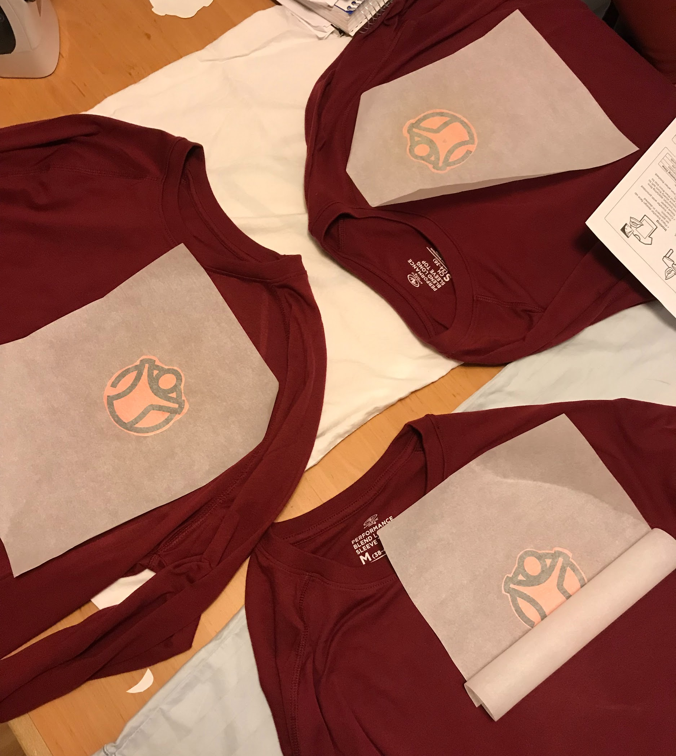
Project Execution
Setting Goals
Sell 20 tickets/person = 100 tickets sold
Advertise/sell tickets on certain days, and at specific locations
Meeting Goals
Sold more than 20 tickets/person = 117 tickets sold
Raised over $600 to send to Save the Children Foundation

Slide 5
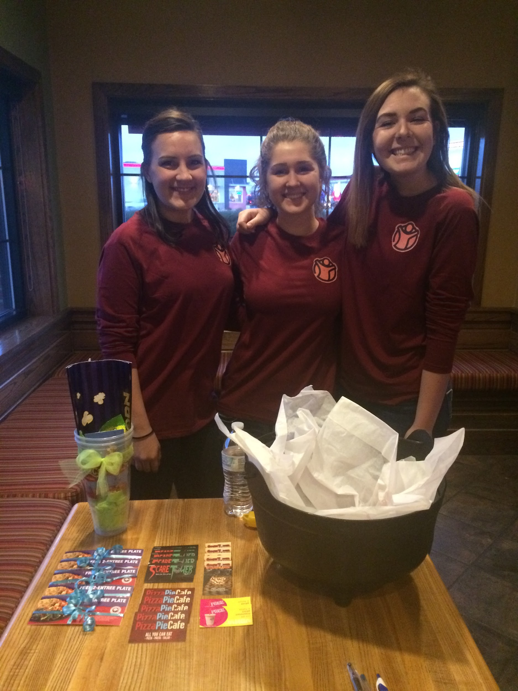
Project Roadblocks
We found it difficult selling tickets door to door
Not a lot of people had the money to donate and/or buy a ticket
College town, low interest in spending money
People who said they would go and pay at the door, bailed last minute
Walmart and Broulims wouldn’t let us advertise outside their store
Finding effective ways to accept money
How we overcame them
Finding the right crowd to sell to
Referrals
Building a network

Slide 6
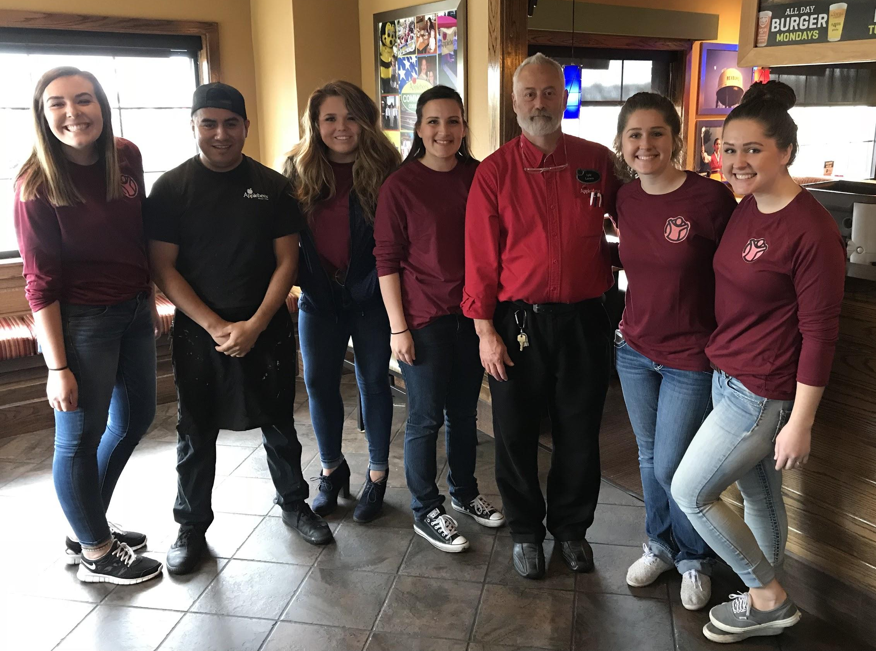
Project Feedback
People loved the sense of community
Didn’t know it was a student-run event, found it professional and well done
Lyle said it was one of the best outcomes he has had with the Applebee’s Flapjack Fundraisers
Good food, had a blast!

Slide 7
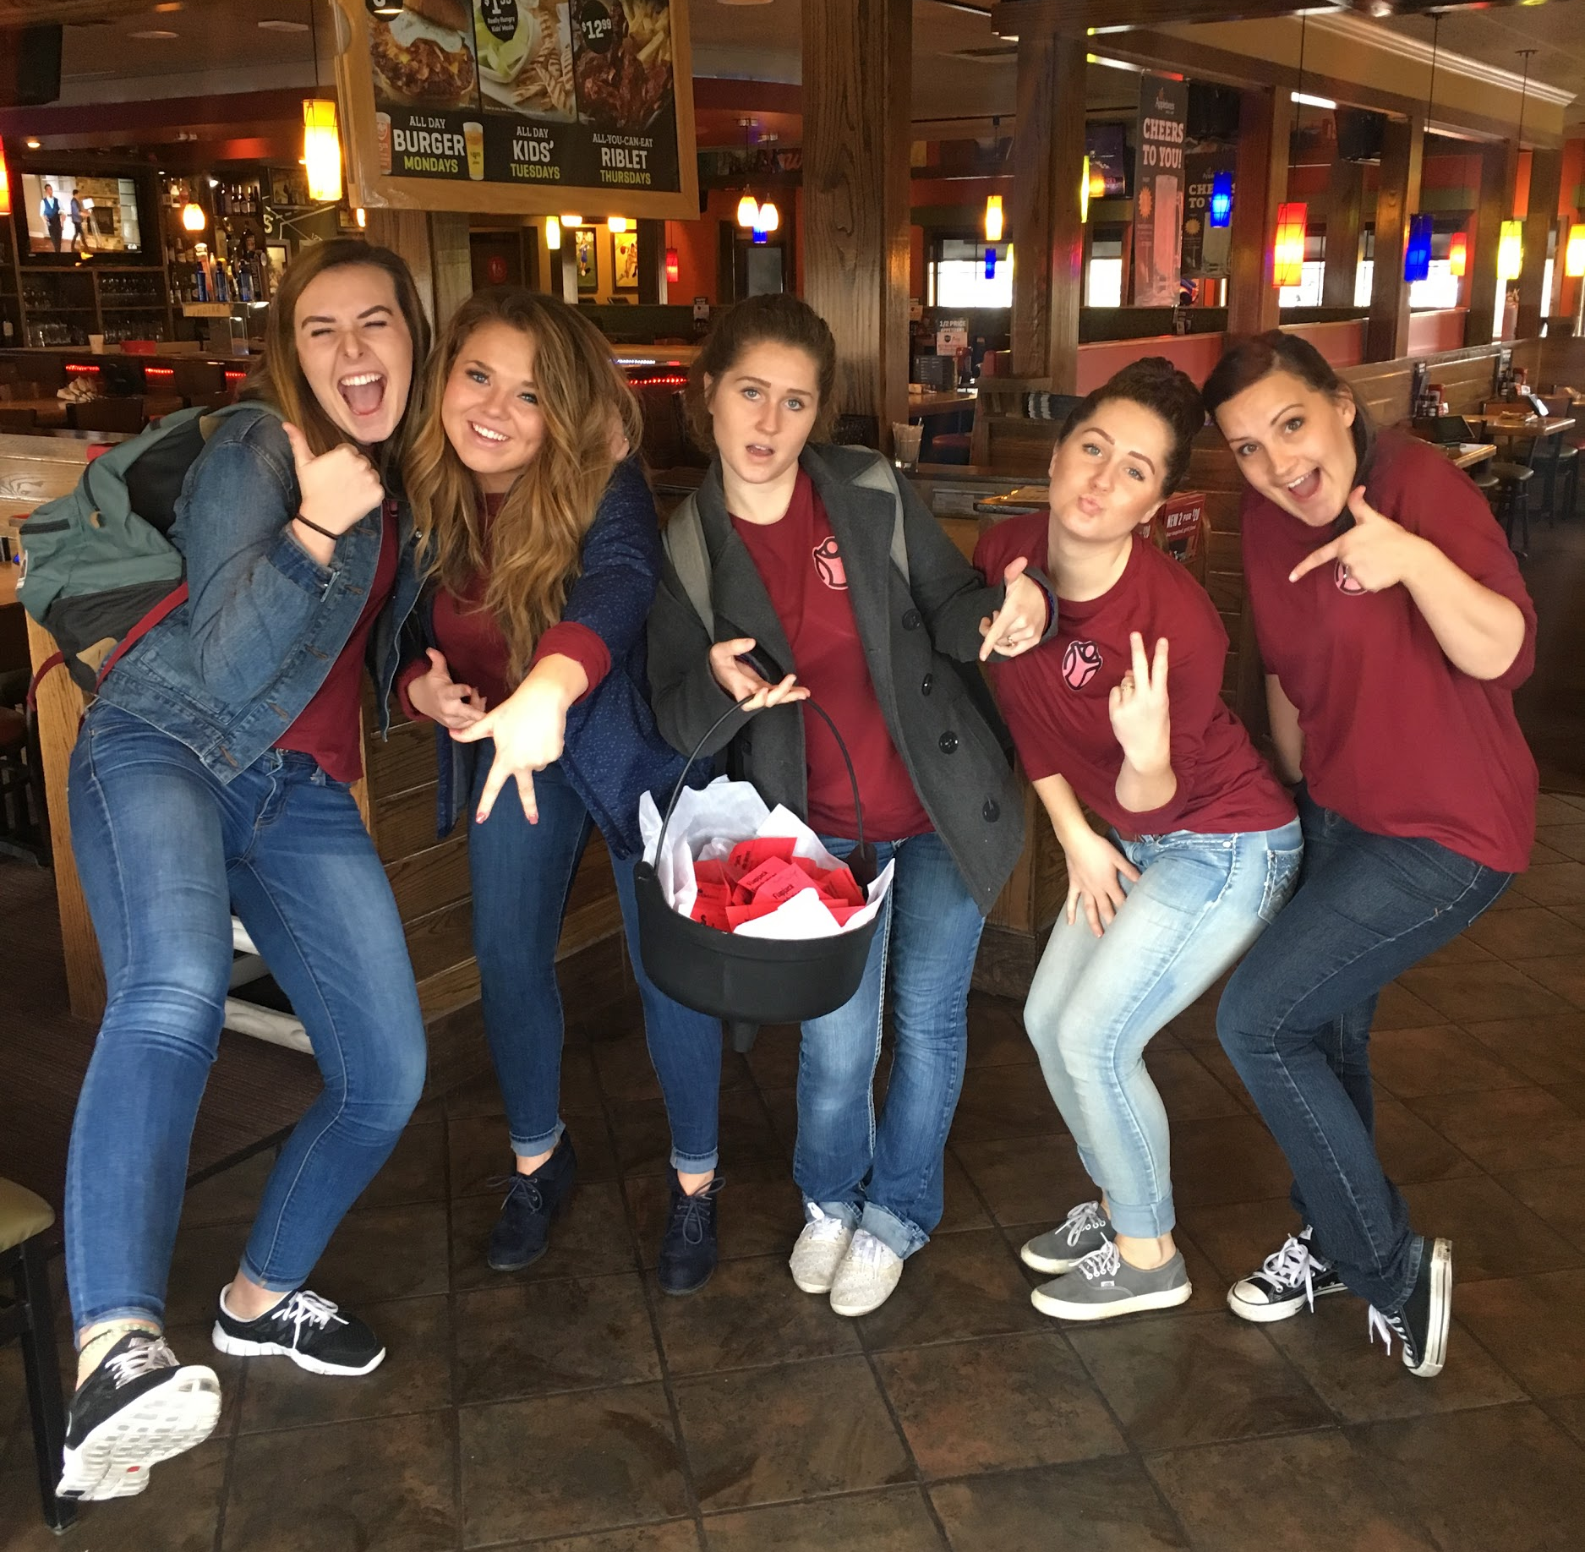
Project Aftermath
Helped clean up all the tables before Applebee’s opened at 11 am
Counted total cash and paid Applebee’s the other $300 we owed them
Left for Walmart to collect a $20 donation and put all cash into a money order
Called Save the Children asking how to specifically donate to Hurricane Harvey, and mailed the fundraised money

Slide 8
Individual Lessons Learned

